Slide 1
U.S. Shadow Banks Unleashed
Presented by: Han Qi, Sam Farnoushfar, & Sean Dubiel

Slide 2
Cast of Characters
Regulated Banks -- Deposit Insurance, Emergency Funding, tightly regulated (for a while)
Shadow Banks -- Investment Banks, Hedge Funds
Lightly regulated
Savvy, sophisticated investors
Morre risk, more reward
Government-Sponsored Enterprises -- Supported home ownership by purchasing mortgages
Fannie Mae -- Purchased low and moderate-income mortgages
Freddie Mac -- Supported Saving and Loans hobbled by rising inflation and interest
Fancy Financial Tools -- Mortgage Backed Securities, Repurchase Agreements

Slide 3
Banking after the Great Depression
Banks limited to a single state, sometimes only one branch in the state
Interest Rates on Savings deposits limited by national regulations
Interest Rates on loans constrained by state usury laws
Prohibited from “Investment bank” functions due to Glass-Steagall Act of 1933
“Regulated banks were kept small, local, and safe…”
“The focus was on creating a system that was unlikely to collapse…”

Slide 4
Inflation and “Safe” Banking
After 1933, prohibitions and caps on interest rates prevented banks from making risky investments -- Regulation Q of the Federal Reserve Board
Assumed inflation would remain low and stable
Banks were unable to raise deposit rates during inflation in the 1970s.
Investors turned to uninsured deposits with investment banks not subject to regulation
Legislations was passed to amend Regulation Q in 1980 but with a 5 years phase out of rates
“Genie was out of the bottle”

Slide 5
Investment Banks Unleashed
Switch from regulated banks to investment banks focused on investors with “wholesale” funds (well above FDIC insurance) -- the sophisticated investor
Two main tools
Money market mutual funds -- rates similar to traditional deposits, “insurance” was the underlying asset
Repurchase Agreement -- asset sold to a depositor with an agreement to buy it back at a fixed price at a later time
Investor’s “interest rate” is the difference between the selling and purchase price
Investor gets to keep the asset if the shadow bank can’t repurchase it
Usually offered with a “haircut” -- a discount on the initial selling price
Migration of investments led regulated banks to sell securitized assets to investment banks

Slide 6
GSEs and Securitization Done Safely
Government-Sponsored entities created liquidity via a secondary mortgage market
Fannie Mae held on to loans but got squeezed by rising interest rates
Freddie Mac sold mortgages in bundles to better help out Savings and Loans and offered insurance against default
By 1990s, both Fannie Mae and Freddie Mac securitized loans
Mortgage-backed securitizations -- mortgages bundled and sold to investors with a guarantee that the underlying borrowers would maintain payments
Mortgage backed securities comprised only of “safe mortgages” conforming to strict rules
Min downpayments, loan limits, min credit score

Slide 7
Private Label, Please
Inflation led to risk taking and ultimately bank failure in the 1970s and 1980’s led to capital buffers above existing Basel Committee rules
Continental Illinois Bank and Trust -- massive deposits loaned to risky borrowers
Savings and Loan crisis -- rising inflation led the bank to make riskier speculative loans
Regulated banks directed to hold 5% of total assets
Regulated banks had incentive to remove assets by bundling safe loans (mortgages) as “private label” and selling to shadow banks
Investment banks had much lower buffers and cheaper to have a loan on its books
Incentivized a market where regulated banks create loans, bundle them, and sell to investment banks

Slide 8
Deregulation during the 1970, 80, and 90s
Reduced cost of communication and transportation (ATMs) reduced the benefits of local banking
Political action for Inter-state banking
Regulated banks allowed by the Federal Reserve to take on investment and insurance activities
Revenue limits of these activities increased to 25% by 1996
Glass-Steagall Act repealed in 1999
“The US regulated banking industry thus entered the 2000s unencumbered by limits on interest rates, constraints on location, or prohibition on engaging in investment banking.”

Slide 9
The Dual Banking System
Deregulation led to only two “universal” banks: Citi and JP Morgan
Remaining regulated banks focused on making loans, securitizing them, and selling them to investment banks
What could go wrong?

Slide 10
Content
Bank Regulators Looking Under the Wrong Lamppost
Investment Bankers Become Masters of the Universe

Slide 11
The Regulatory System in the U.S.
much more Complex and splintered than in other major countries.
1863, The Office of the Comptroller of the Currency (OCC) was created
1913, the Federal Reserve Act was approved to wrest control of the nation’s finances from banks
1929, the Great Depression lead to even more banking regulation instituted by President Franklin D. Roosevelt as part of the provisions under the New Deal.
1933, The Glass-Steagall Act created the Federal Deposit Insurance Corporation (FDIC), which implemented regulation of deposit interest rates, and separated commercial from investment banking.
Sharp split -----lead to Shadow Banking System mushroom
“...Focused on compliance with rules on behavior rather than financial safety.” (p55)

Slide 12
The Regulatory System in the U.S.
Bank financial safety was overseen by three regulators
The OCC---Federally chartered banks
The FED---the holding companies of the large and complex banks
The FDIC
Oversee the deposit insurance system
Resolve insolvent banks
So, Different regulators make it hard to charge the regulation of US banks.
Supervise banks’ capital buffers
Risks and costs of bank failures

Slide 13
Consequence of different regulators
the sluggish response to the challenges to bank competitiveness
higher inflation supported the expansion of the shadow banking sector
the “originate to distribute” model that failed over the 2008 crisis
the slow response to change
eroded capital buffers in the Euro area.

Slide 14
Post-Crisis Re-Regulation: Nonbank regulatory system
The agencies
the Securities and Exchange Commission (SEC)
the Commodity Futures Trading Commission
The Net Capital Rule
Aim: ensuring that customers were able to recover their money in the event of a bankruptcy rather than protecting broker-dealers from going broke.

Slide 15
Post-Crisis Re-Regulation: Nonbank regulatory system
The Splintered Regulatory System and the Relatively Lax Regulation:
no institution was charged with overseeing the entire dual banking system.
the Fed’s rejection of regulation of investment banks

Slide 16
Summaries
The heavily regulated commercial banks had been losing increasing market share to less-regulated and innovative financial institutions.
the Gramm-Leach-Bliley Act of 1999 repealed significant aspects of the Glass-Steagall Act, which had served to sever investment banking and insurance services from commercial banking
From 1999 onwards, a bank could now offer commercial banking, securities, and insurance services under one roof.
All of this deregulation helped to accelerate a trend towards increasing the complexity of banking organizations as they moved to greater consolidation and conglomeration.
Banks began offering new financial products like derivatives and began packaging traditional financial assets like mortgages together through a process of securitization

Slide 17
Investment Banks
The essence of investment banking------ “broker-dealer” (smooth functioning)
Broker：accepting money from investors and placing that money on their behalf in the market
Dealer：initiates these trades
Together: take money from individuals and invest it

Slide 18
The Information Technology Revolution
Gradually transformed the markets investment banks served
Settlement of trade
Lower costs of trading and lax regulations created the hedge fund industry

Slide 19
The Operating Mechanism of the Investment Banks
Traditionally when a home owner made mortgage payment, it went to the lender
In the new system, lenders sell the mortgages to Investment banks
Investment banks combine all sorts of mortgages and loans to create complex derivatives called CDOs
Investment banks sold the CDOs to investors
Which meant that the payment from home owners was going to the Investors
Investment banks paid the Rating Agencies to evaluate the CDOs, majority getting a AAA rating

Slide 20
The Operating Mechanism of the Investment Banks
Neither the Investment banks were interested, the higher CDOs they sold, higher profits they made
Rating Agencies were paid by the Investment banks, they had no liabilities if their ratings of CDOs proved wrong
The investment banks preferred Subprime loans because they had high interest rate
Which resulted in predatory lending that is borrowers were needlessly placed in expensive subprime loans and many were given to people who could not repay
SEC removed leverage limits on borrowing of Investment banks and was not regulating the activities of investment banks

Slide 21
Charting the Transforming US Financial System
Early 1980’s: The banking system was dominated by small, locally regulated banks which kept most of their loans on their balance sheets
2002: By this point, the banking industry had been transformed by mergers and acquisitions such as the kind that led to the rise of Bank of America, Citi, and JP Morgan
Widespread use of securitized assets to sell standardized consumer loans to shadow banks while retaining riskier commercial loans
Securitization –along with deposits being driven away from the regulated FDIC insured banking system towards shadow banks in seek of higher returns– contributes to massive growth in the shadow banking sector
Uninsured bank deposits (due to exceeding the insurance cap) within the regulated banking system shift toward money market mutual funds and repurchase agreements - ultimately rising from under 10% of output in 1980 to over 40% by the end of 2002

Slide 22
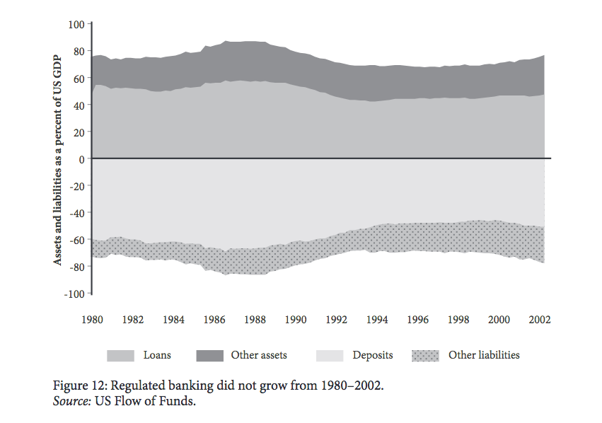
Despite the emergence of ”national banks” the size of the US regulated banking industry remained relatively stable from 1980-2002
Fluctuated within a narrow band, large bump in the late 80’s reflects the turbulence in the Savings and Loans industry
Ultimately, assets represent 75% of output in 2002, nearly unchanged from the amount in 1980
While the share of assets appears consistent, this hides the underlying transformation of the regulated banking sector

Slide 23
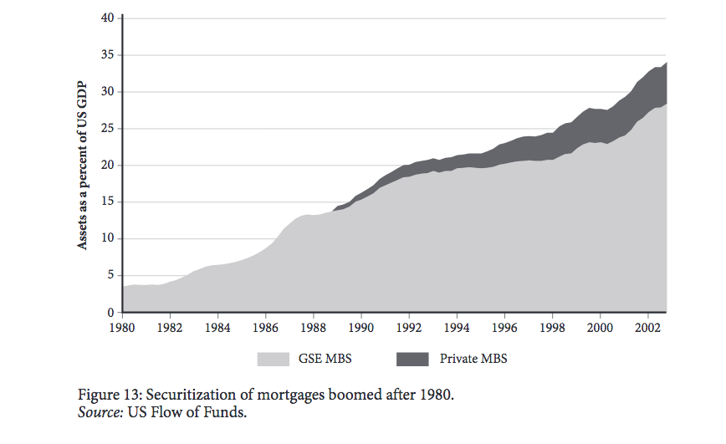
Banks were making more loans which were subsequently being bundled and sold to shadow banks as mortgage-backed securities (MBS)
Most of this was done through the Government Sponsored Enterprises (GSEs) of Fannie Mae and Freddie Mac
Nearly ten-fold increase in the amount of GSE MBS compared to the size of the economy
Growth from slightly over 3% of output in 1980 to nearly 30% at the end of 2002

Slide 24
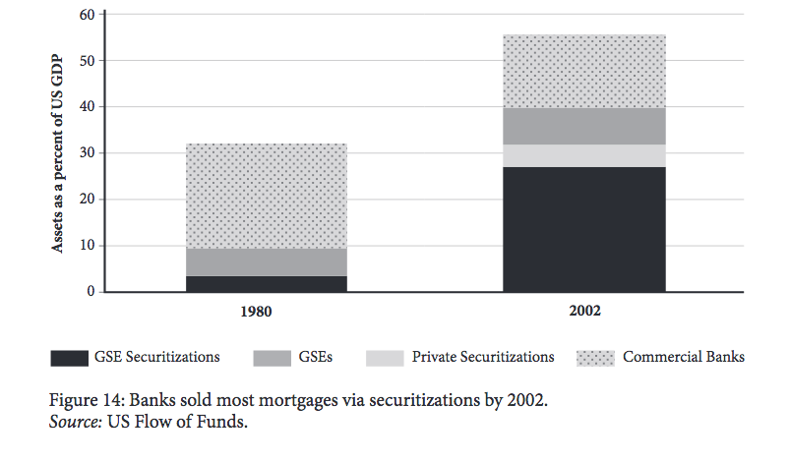
The dotted segment represents residential mortgages; In 1980 banks kept 75% of these on their books and sold about a tenth as GSE securitized assets
By 2002, banks only kept about 25% of residential mortgages on their books while selling half through GSE securitizations and private securitizations
The “originate-to-distribute” model of securitizing bank loans was already well established by the end of 2002 where over a third of all bank loans were being securitized and sold to investors

Slide 25
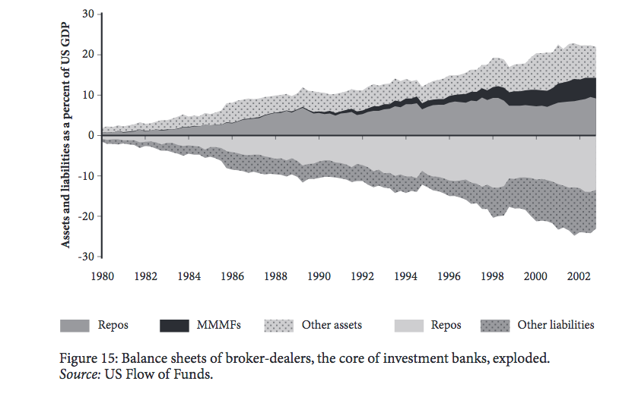
The changing US financial system mainly benefited the investment banks whose assets multiplied tenfold as a ratio to output (2% in 1980 to over 20% in 2002)
Medium gray and black areas above represent inflow of large deposits of wholesale cash via repurchase agreements and money market mutual funds
Light gray area represents cash being subsequently lent out to firms such as hedge funds via repos
Lightly regulated broker-dealers borrowed cash from investors and then lent it out to less regulated firms like hedge funds who mainly bought and sold securitized assets and derivatives – this mechanism was at the heart of the shadow banking system

Slide 26
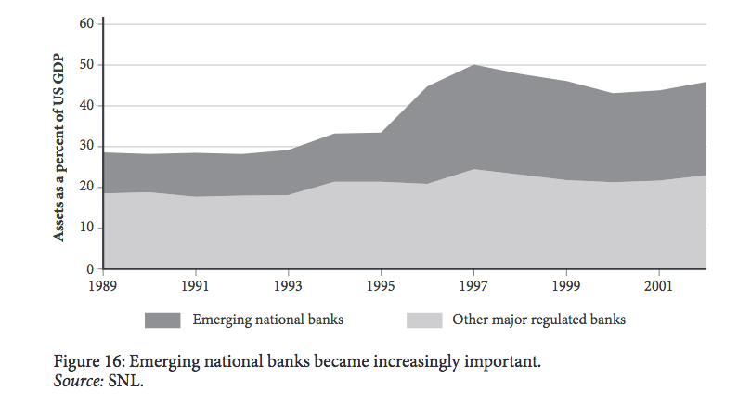
Size of regulated banks expanded rapidly
By 2002 there were three main super-banks: Bank of America, Citicorp, and JP Morgan
Their aggregate assets accounted for almost 25% of the US economy, double the 1989 levels
Other regulated banks however maintained relatively consistent growth as a proportion of GDP

Slide 27
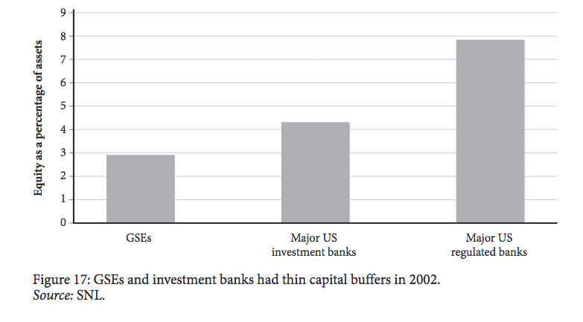
Due to the inability of large US regulated banks to manipulate risk weights via internal risk models, they maintained strong capital buffers
Capital buffers among two of the largest regulated banks –Citi and JP Morgan– were slightly lower as they began to expand their investment banking operations which were subject to less regulation
Fannie Mae and Freddie Mac – having used their low capital buffers depicted above and favorable costs of borrowing to issue bonds and subsequently buy securitized loans – grew tremendously in this period
Their combined assets quintupled from 1989 to grow to 15 percent of the economy by 2002
Generally, GSE’s and the investment banks operated with thin capital buffers between 2-5%

Slide 28
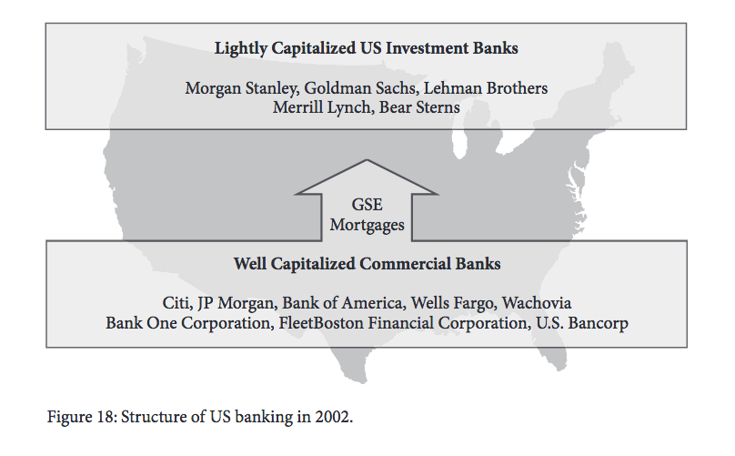
Rule changes in the regulated sector ultimately contributed to the creation of the 3 major national banks, with Citi and JP Morgan moving to mirror their European counterparts in becoming universal banks
The 3 main causes for alarm in the run up to the North Atlantic crisis:
1: Rapid expansion of lightly regulated investment banks and a failure to account for this rapid growth having spillover effects to other sectors, possibly resulting in collapse of the financial system
2: Increased participation in the US market by European universal banks contributing to the expansion of the investment banks and the derivatives market
Competition among the middle tier smaller investment banks depicted above (Goldman Sachs, Bear Stearns, & Lehman Brothers) with major European investment banks (Deutsche Bank, Barclays, Credit Suisse, UBS) would ultimately lead them to trouble in the run up to the crisis since they lacked the deep pockets and stable backing of their European counterparts
3: Rapid acceleration in home prices. By 2002, house prices were rising by 10% a year while inflation remained stable, with real house prices having already risen by a third compared to 1993

